Slide 1
Employee Data Analysis using Excel
STUDENT NAME: ABINAYA.G
REGISTER NO: 312204230
DEPARTMENT: B.COM( ACCOUNTING AND FINANCE)
COLLEGE : ANNAI VIOLET ARTS & SCIENCE COLLEGE

Slide 2
PROJECT TITLE
Employee Performance Analysis using Excel

Slide 3


AGENDA
Problem Statement
Project Overview
End Users
Our Solution and Proposition
Dataset Description
Modelling Approach
Results and Discussion
Conclusion
3/21/2024 Annual Review

Slide 4

PROBLEM STATEMENT
Problem Statement: You are a Human Resource (HR) analyst at a company that wants to improve employee performance and productivity. To do this, you need to conduct an analysis of employee performance data using Microsoft Excel The dataset provided contains information on employee performance metrics over the last year, including Employee ID: Unique identifier for each employee. Employee Name: Name of the employee. Department: The department in which the employee works (e.g., Sales, IT, Marketing, etc.). Monthly Performance Scores: Scores (on a scale of 1-100) for each month based on key performance indicators (KPIs).

Slide 5

PROJECT OVERVIEW
The “Employee Performance Analysis using Excel” project focuses on evaluating and understanding key performance metrics of employees within a company using Microsoft Excel. The aim is to utilize Excel’s data manipulation, analysis, and visualization tools to assess employee productivity and performance trends over time, providing insights to the HR department for strategic decision-making

Slide 6

WHO ARE THE END USERS?
L end users of an Employee Performance Analysis using Excel project are typically stakeholders within an
organization who require insights into employee performance to make strategic decisions. These may include:
1.Human Resources (HR) Department
2.Team Managers and Department Heads
3.Senior Management / Executives
4. Learning and Development (L&D) Teams
5. Employee Relations Team

Slide 7

OUR SOLUTION AND ITS VALUE PROPOSITIONOur
solution offers a comprehensive analysis of employee performance by leveraging Microsoft Excel’s data manipulation and visualization tools. This solution provides HR professionals, managers, and executives with detailed insights into workforce productivity, enabling data-driven decision-making to optimize employee engagement, productivity, and retention.

Slide 8
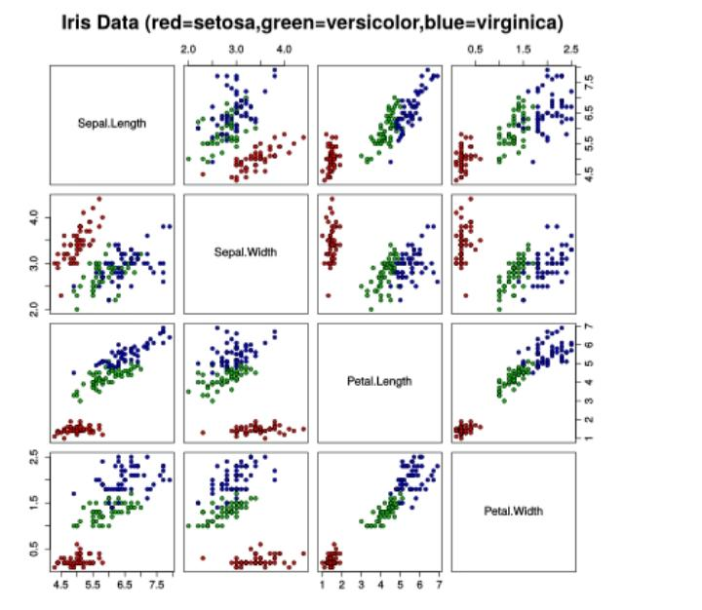
Dataset Description
A data set (or dataset) is a collection of data. In the case of tabular data, a data set corresponds to one or more database tables, where every column of a table represents a particular variable, and each row corresponds to a given record of the data set in question. The data set lists values for each of the variables, such as for example height and weight of an object, for each member of the data set. Data sets can also consist of a collection of documents or files.

Slide 9

THE "WOW" IN OUR SOLUTION
For an Employee Performance Analysis using Excel, you can add a “wow” factor by leveraging advanced features like dynamic dashboards, visualizations, and automated analysis tools. Here’s how you can do that:
1. Dynamic Dashboards
2. Visualizations
3. Automated Analysis
4. Advanced Techniques
3/21/2024 Annual Review
9

Slide 10
MODELLING
Employee performance analysis using Excel modeling can help in evaluating, tracking, and improving employee productivity, efficiency, and contributions. Here’s a step-by-step guide to creating a basic employee performance analysis model in Excel:
1. Data Collection
2. Setting Up Excel Sheets
3. KPI Metrics Setup 4. Weighted Scoring Model 5. Analysis Using Excel Functions
10

Slide 11
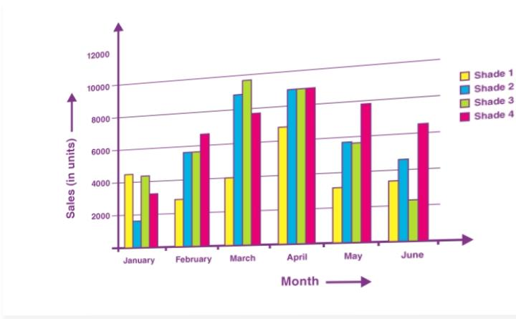
RESULTS
11

Slide 12
conclusion
The Employee Performance Analysis using Excel provided a comprehensive and structured approach to evaluating individual and team performance within the organization. The model incorporated key performance indicators (KPIs), weighted scoring systems, and advanced data visualization tools, which enabled actionable insights and data-driven decision-making.

